Slide 1
H3D C++ programming
Haptics

Slide 2
Haptics
Geometries/surfaces
  Geometric primitive
Force effects
  Free space force effect
  Input: device state(position,velocity,orientation)
  Output: force, torque

Slide 3
Adding haptic objects
traverseSG( TraverseInfo &ti ) in any node:
  ti.addForceEffect
  ti.addHapticShape
Using HAPIForceEffect and HAPIHapticShape objects.
In effect until next traversal.
Can add to individual haptics device.

Slide 4
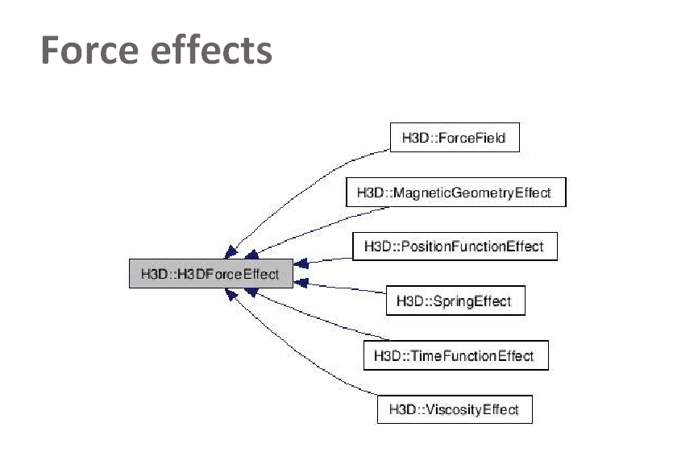
Force effects

Slide 5
Things to be aware of
Don't access the field network directly from HAPI objects.
Thread safe communication.
If using same HAPI object to add each loop
  Node cannot be used in several places in the scenegraph.

Slide 6
Example: SpringEffect
void SpringEffect::traverseSG( TraverseInfo &ti ) {
if( ti.hapticsEnabled() ) {
int device_index = deviceIndex->getValue();
HapticsDevice *hd = ti.getHapticsDevice( device_index );
const Vec3f &pos = hd->trackerPosition->getValue();
const Vec3f &spring_pos = position->getValue();
H3DFloat distance = ( pos - spring_pos ).length();
if( active->getValue() ) {
if( distance >= escapeDistance->getValue() ) {
active->setValue( false, id );
} else {
ti.addForceEffect( device_index,
new HapticSpring( spring_pos,
springConstant->getValue(),
1 ) );
}
} else {
if( distance <= startDistance->getValue() ) {
active->setValue( true, id );
ti.addForceEffect( device_index,
new HapticSpring( spring_pos,
springConstant->getValue(),
1 ) );
}
}
}

Slide 7
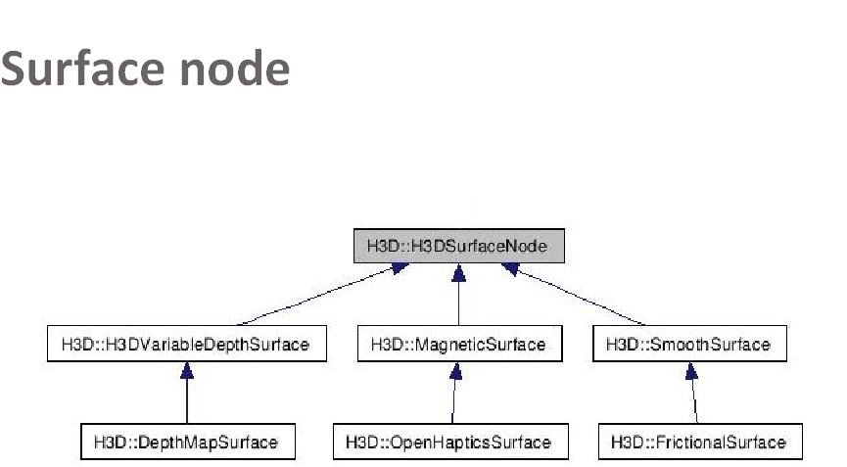

Slide 8
Custom surface node
Implement a HAPISurfaceObject
Make a H3DSurfaceNode with an X3D interface to parameters
  Thread safe

Slide 9
Exercise - New geometry
Examine source code to Sphere and Cylinder.
Write an implementation for a torus geometry!

Slide 10
Exercise – New force model
Look at the SpringEffect and ForceField nodes.
Write your own force model and create a new node with an interface to it. The force model could e.g.
  Restrict motion to the xz-plane.
  Restrict motion to a line.

Slide 11
Exercise - C++ Applications
Examine source code to H3DLoad.cpp
Write a modified H3DLoader to:
  Create a HLHapticsDevice node before loading an .X3D file

